Slide 1

https://cdn4.geckoandfly.com/wp-content/uploads/2019/06/google-slides-free-template-powerpoint-05.jpg
Project Title:
Easy Life BGC

Slide 2
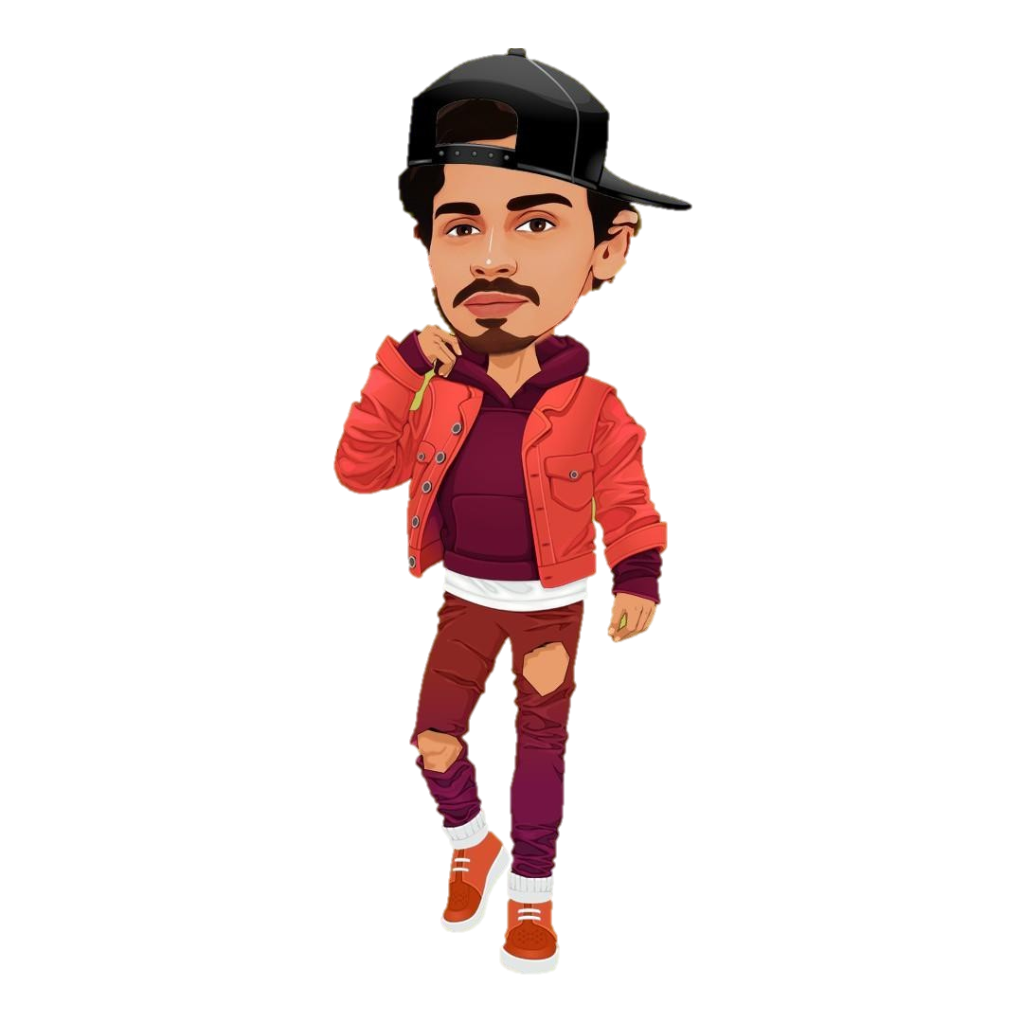

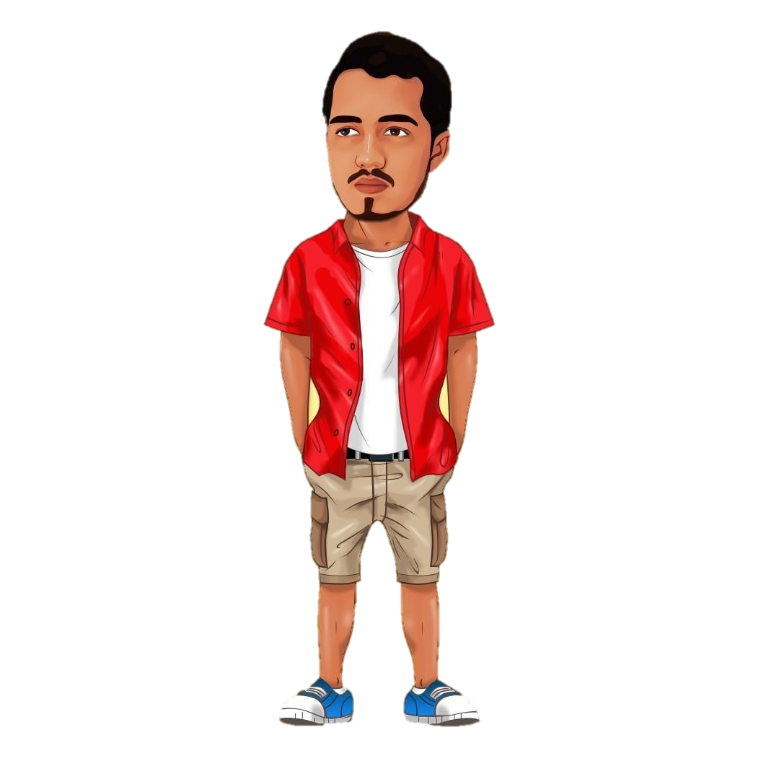
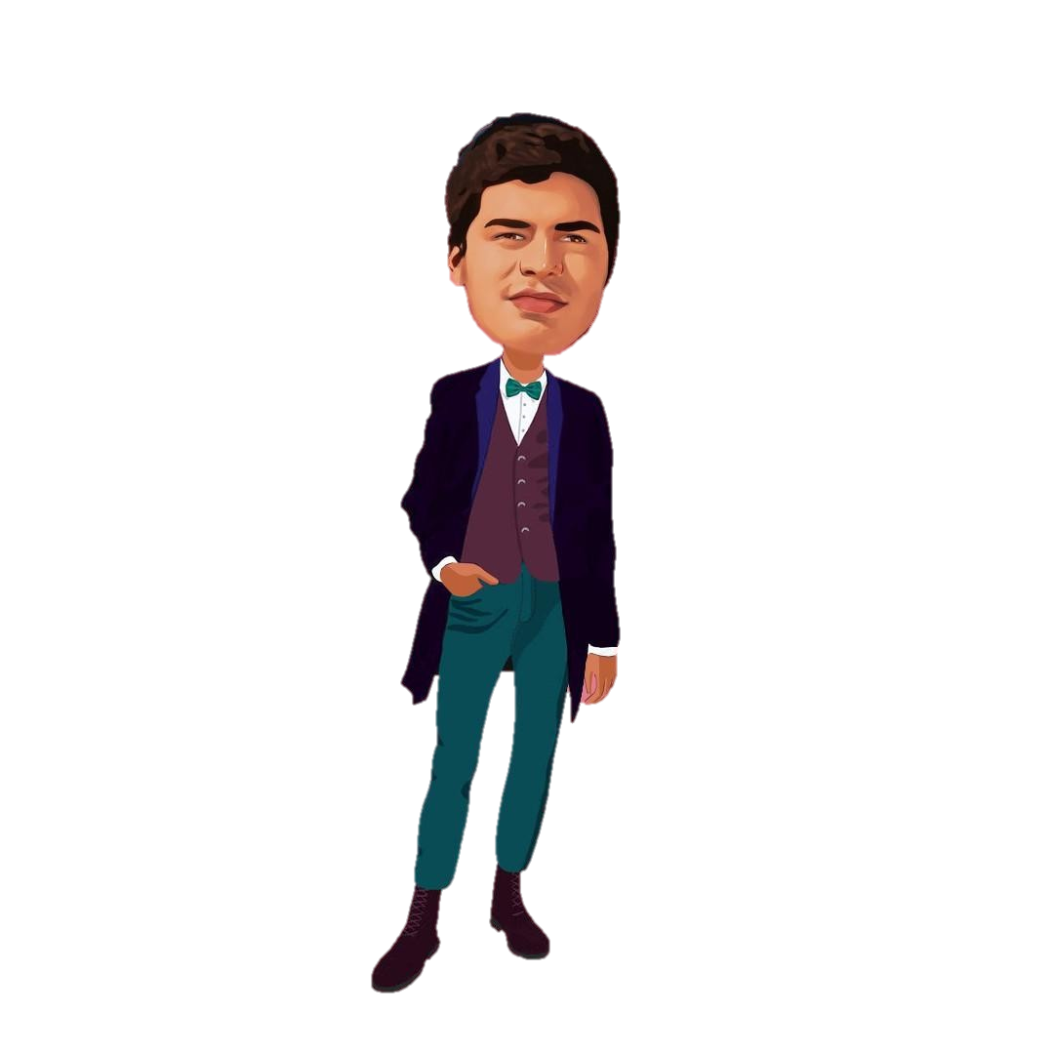
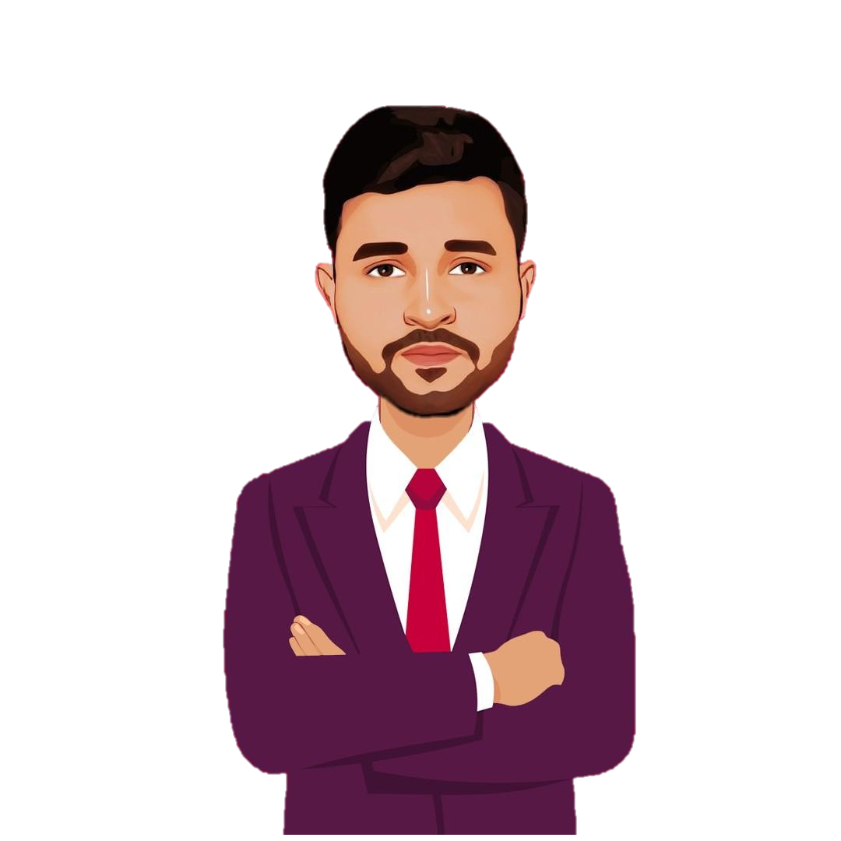
Diljsldfdfaf
Ekthiar Uddin ID_220238142
Faiyaz Bin Jahangir
ID_220238112
MD Lokman Huda Hriday
ID_220238135
Ismail Hosen
ID_220238117
Md. Zahed Hossain
ID_220238125
TEAM
MEMBER

Slide 3
Diljsldfdfaf
Ekthiar Uddin ID_220238142
Ismail Hosen
ID_220238127
Faiyaz Bin Jahangir
ID_220238112
MD Lokman Huda Hriday
ID_220238135
Md. Zahed Hossain
ID_220238125
TEAM
MEMBER

Slide 4
How to Work our
Software.

Slide 5



Sign In
Or use your account
Hello, Friend!
Enter your details and start journey with us
Name
Student ID
SIGN IN
SIGUP

Slide 6
Create Account
Or use your email for registration
Welcome Back!
To keep connected with us please login with your personal info
Name
Student ID
Department
SIGN IN
Semester
Section
SIGNUP

Slide 7


USER NAME Sign out
Monday
Feb 12,24
09:30–10:20 | 10:25-11:15 | 11:20-12:10 | 12:15-01:05 | 01:10-02:00 | 02:05-02:55
MP (SRM) – 215 | SAD (FA) - 223 | MP LAB (SRM) – 126 |  | DC (TS) – 223
MP(SRM)-223 |  | SAD(FA)-126 | OS(MB) -233 | DBMS(MUE) - 233
OS(MB)-118 | OS LAB(BRC) -121 | OS(MB) – 233 | BLL (AB) -228 |  | SAD (FA) -221
SDP-1 (FA)-221 |  | DBMS(MUE) – 215 | DC (TS)-131 | DBMS LAB (MUE)- 118
TRANSPORTS
CHANDGAON
OXYGEN
GEC
AGRABAD
New MARKET
KAPTAI Rastar MATHA

Slide 8
USER NAME Sign out
Tuesday
Feb 13,24
09:30–10:20 | 10:25-11:15 | 11:20-12:10 | 12:15-01:05 | 01:10-02:00 | 02:05-02:55
MP (SRM) – 215 | SAD (FA) - 223 | MP LAB (SRM) – 126 |  | DC (TS) – 223
MP(SRM)-223 |  | SAD(FA)-126 | OS(MB) -233 | DBMS(MUE) - 233
OS(MB)-118 | OS LAB(BRC) -121 | OS(MB) – 233 | BLL (AB) -228 |  | SAD (FA) -221
SDP-1 (FA)-221 |  | DBMS(MUE) – 215 | DC (TS)-131 | DBMS LAB (MUE)- 118
TRANSPORTS
CHANDGAON
OXYGEN
GEC
AGRABAD
New MARKET
KAPTAI RASTAR MATHA

Slide 9
USER NAME Sign out
Monday
Feb 12,24
TRANSPORTS
CHANDGAON
11-2285
11-0248
11-1193
11-0708
11-0076
11-0790

Slide 10
USER NAME Sign out
Monday
Feb 12,24
09:30–10:20 | 10:25-11:15 | 11:20-12:10 | 12:15-01:05 | 01:10-02:00 | 02:05-02:55
MP (SRM) – 215 | SAD (FA) - 223 | MP LAB (SRM) – 126 |  | DC (TS) – 223
MP(SRM)-223 |  | SAD(FA)-126 | OS(MB) -233 | DBMS(MUE) - 233
OS(MB)-118 | OS LAB(BRC) -121 | OS(MB) – 233 | BLL (AB) -228 |  | SAD (FA) -221
SDP-1 (FA)-221 |  | DBMS(MUE) – 215 | DC (TS)-131 | DBMS LAB (MUE)- 118
TRANSPORTS
CHANDGAON
OXYGEN
GEC
AGRABAD
New MARKET
KAPTAI Rastar MATHA

Slide 11
USER NAME Sign out
Monday
Feb 12,24
TRANSPORTS
GEC
11-1247
11-0385
11-2909
11-0133
11-0096
11-0426

Slide 12
WHY SHOULD USE OUR
Software?

Slide 13
WHY SHOULD USE OUR Software?
It will be easy to see the class routing. As a result, you can attend the class on time.
Find your bus easily.
Harassment of bus searches will be reduced.
Seats should not be booked from earlier.
The varsity authorities can easily maintain the bus.

Slide 14
THANK YOU

